Slide 1
The Rust Invasion
New Possibilities in the Python Ecosystem
Terence Liu @terencezliu

Slide 2
https://fineartamerica.com/featured/british-invasion-encore-ron-magnes.html

Slide 4
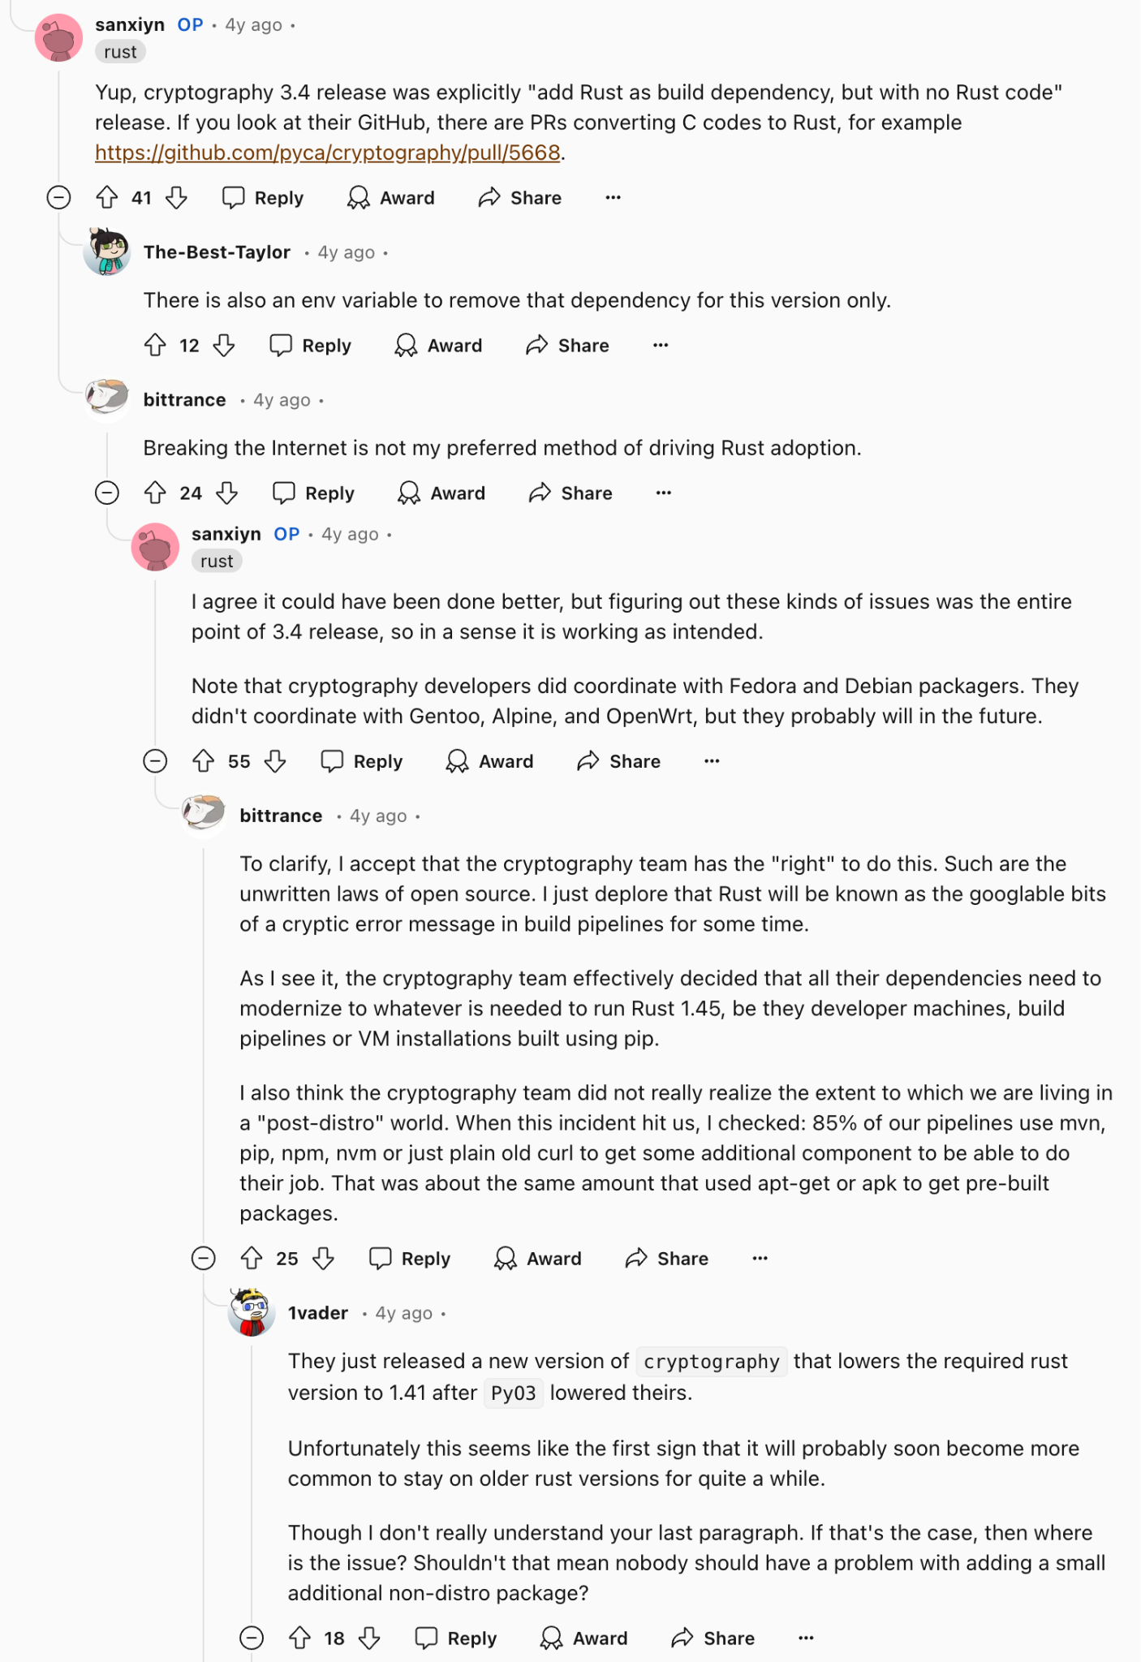
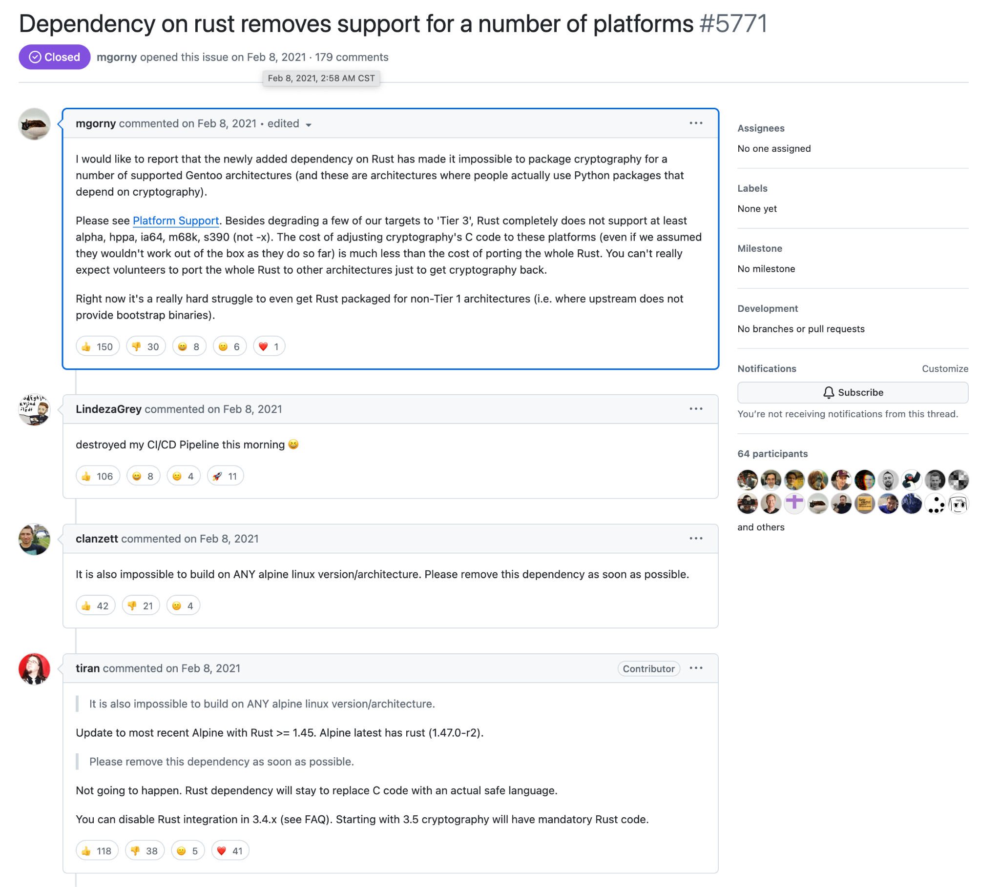
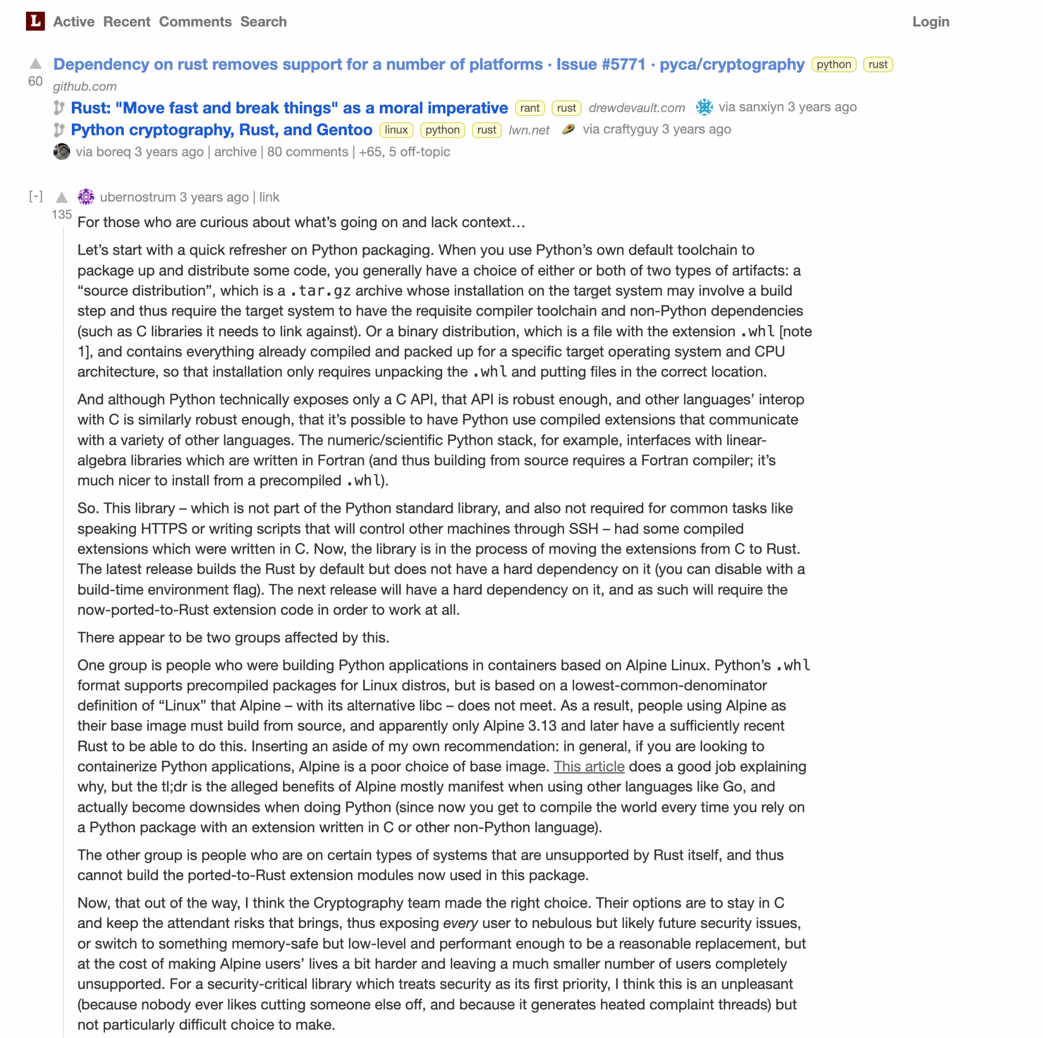
https://github.com/pyca/cryptography/issues/5771
https://lobste.rs/s/f4chm2/dependency_on_rust_removes_support_for
https://www.reddit.com/r/rust/comments/lk5c7l/pythons_cryptography_packages_build_dependency_to/

Slide 5
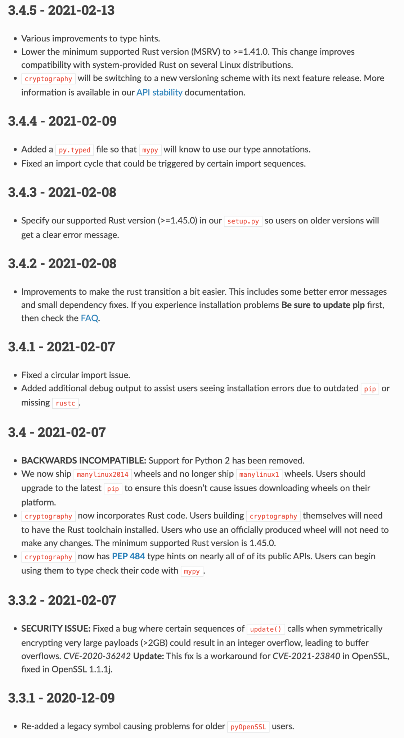
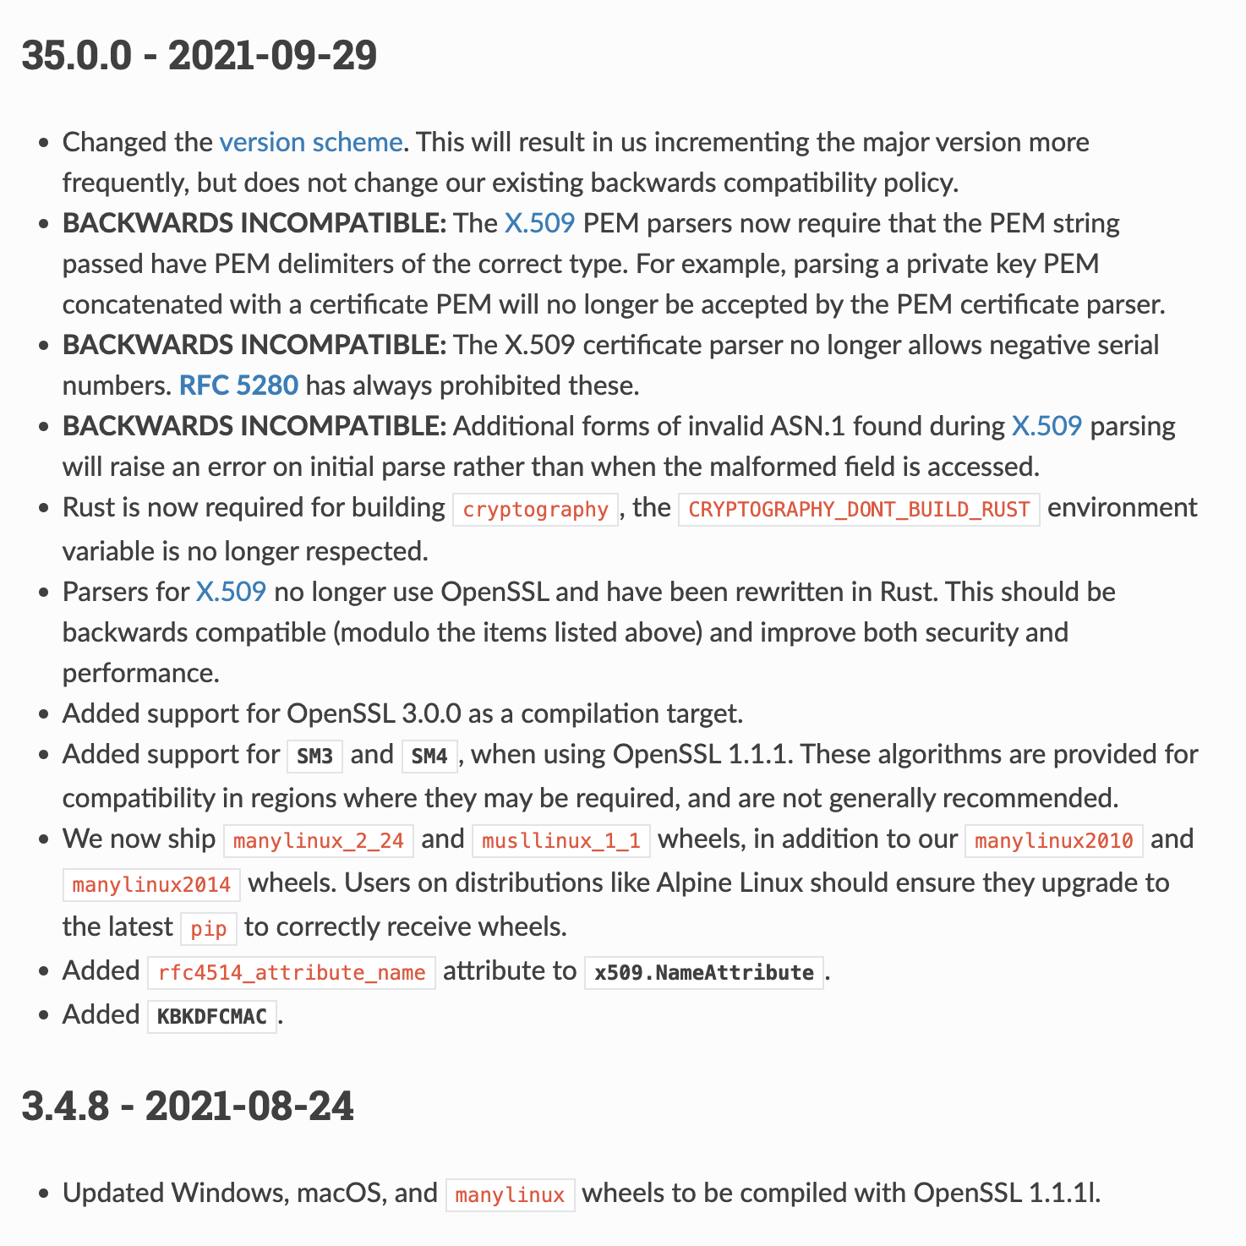
cryptography Changelog

Slide 6
Alternatives to alpine
musl vs glibc - subtle but important differences.
Alternatives: distroless, wolfi
Why I Will Never Use Alpine Linux Ever Again
Using Alpine can make Python Docker builds 50× slower

Slide 7
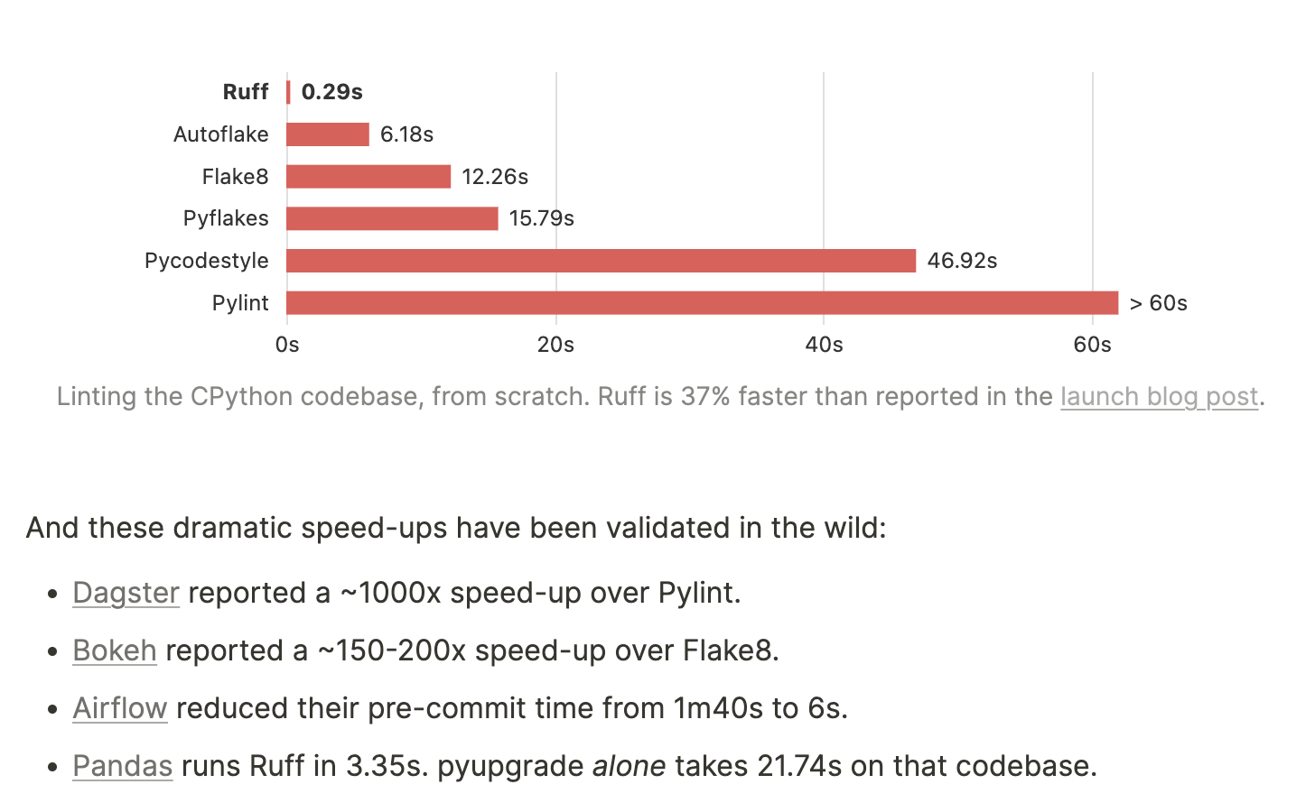
Ruff (2022 - 2023)
Python tooling could be much, much faster
Ruff: The First 200 Releases

Slide 8
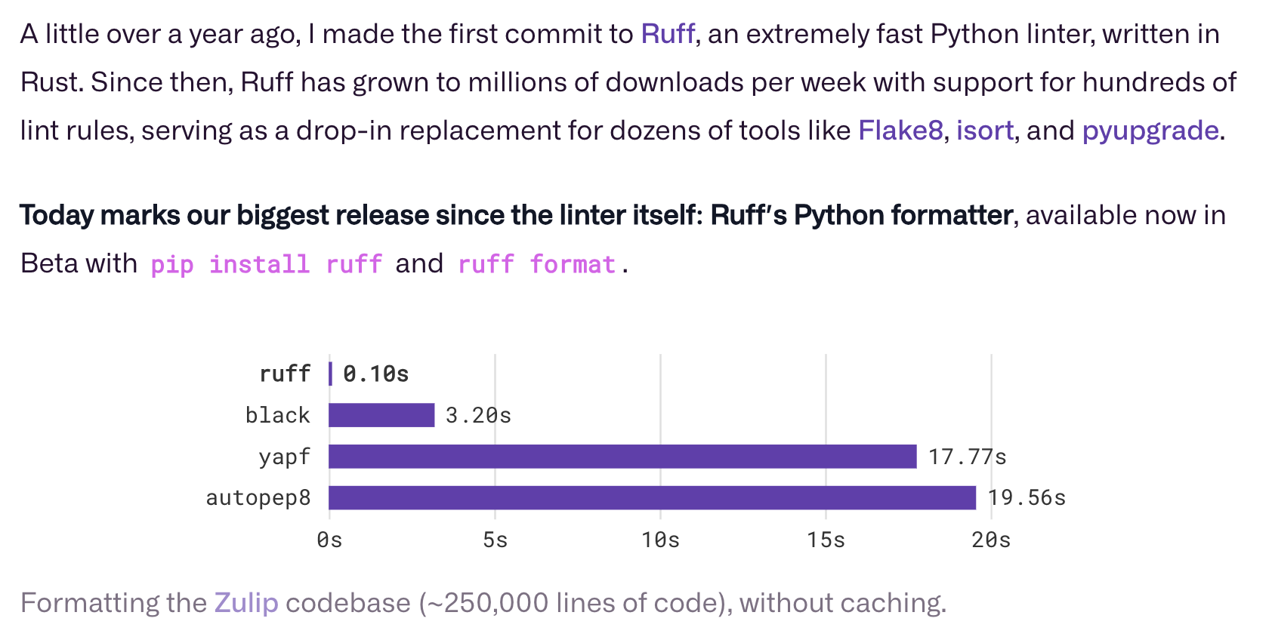
Ruff (2022 - 2023)
The Ruff Formatter

Slide 9
uv (2024)
uv: Python packaging in Rust

Slide 10
uv (2024)
uv: Python packaging in Rust

Slide 11
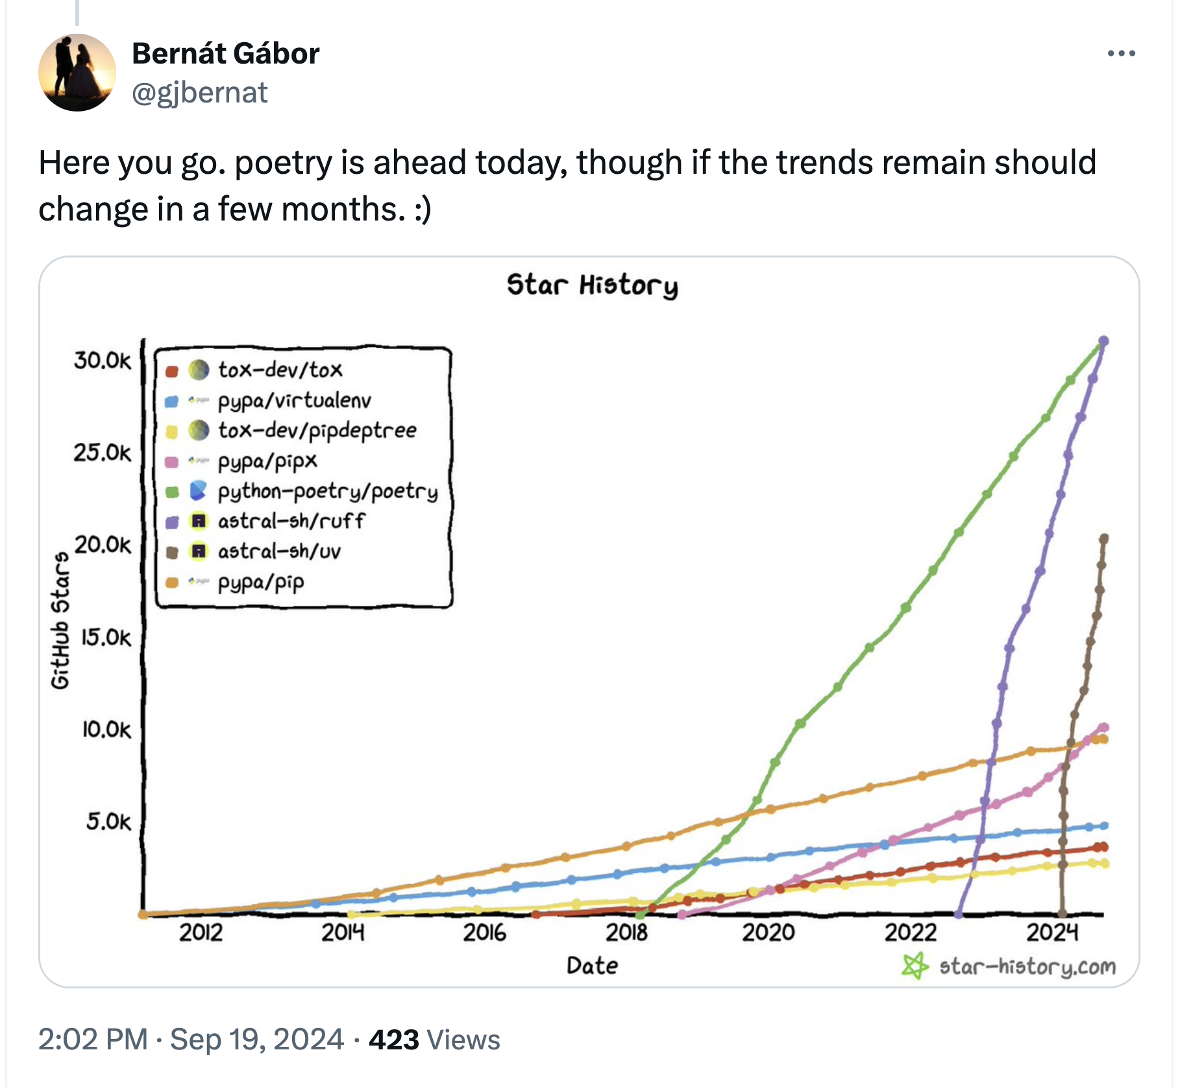
The Buzz
https://x.com/gjbernat/status/1836843228030505053

Slide 12
- from Hynek Schlawack (Sep 30, 2024), also
Production-ready Python Docker Containers with uv

Slide 13
How Do You Develop With Python?
On Mac:
System Python - might be too old
Homebrew Python - rugpulls too often
On Linux:
Package manager
On Windows:
Microsoft Store
In general:
python.org
conda / mamba / micromamba
Run in Docker / Docker Compose and mirror outside for editor integration
Get Your Mac Python From Python.org

Slide 14
Deploy Python Apps to the Cloud
Dockerfiles
Multi-stage builds
Production-ready Python Docker Containers with uv
Articles: Production-ready Docker packaging for Python developers
Docker packaging products for Python

Slide 15
uv Showcase (uv venv & uv pip install)
Big project - 250s -> 30s (no cache)

Slide 16
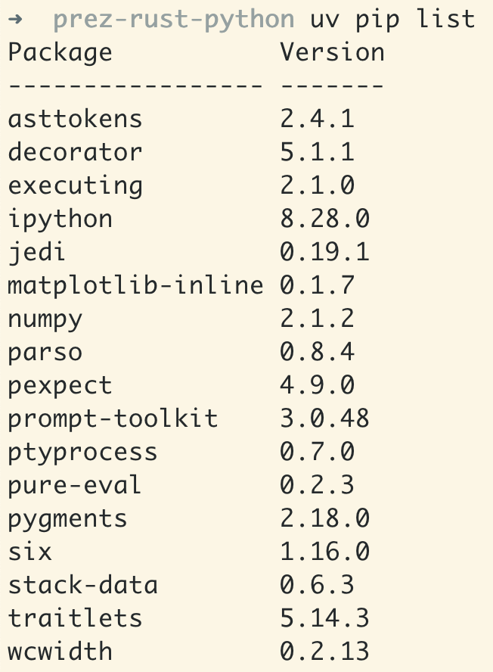
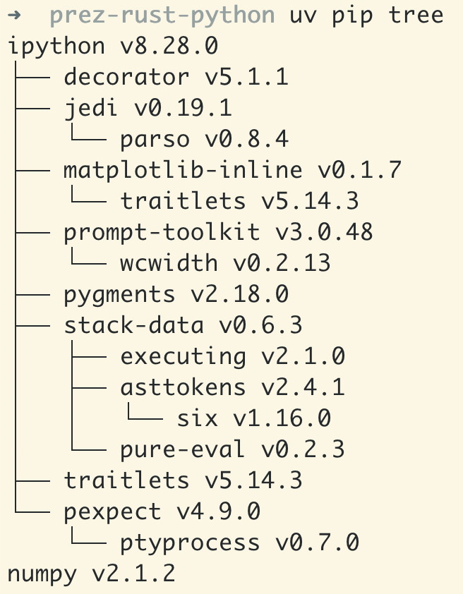
uv Showcase (uv pip list & uv pip tree)

Slide 17
uv Showcase (uv python)

Slide 18
uv Showcase (uv init & uv add & uv sync)

Slide 19
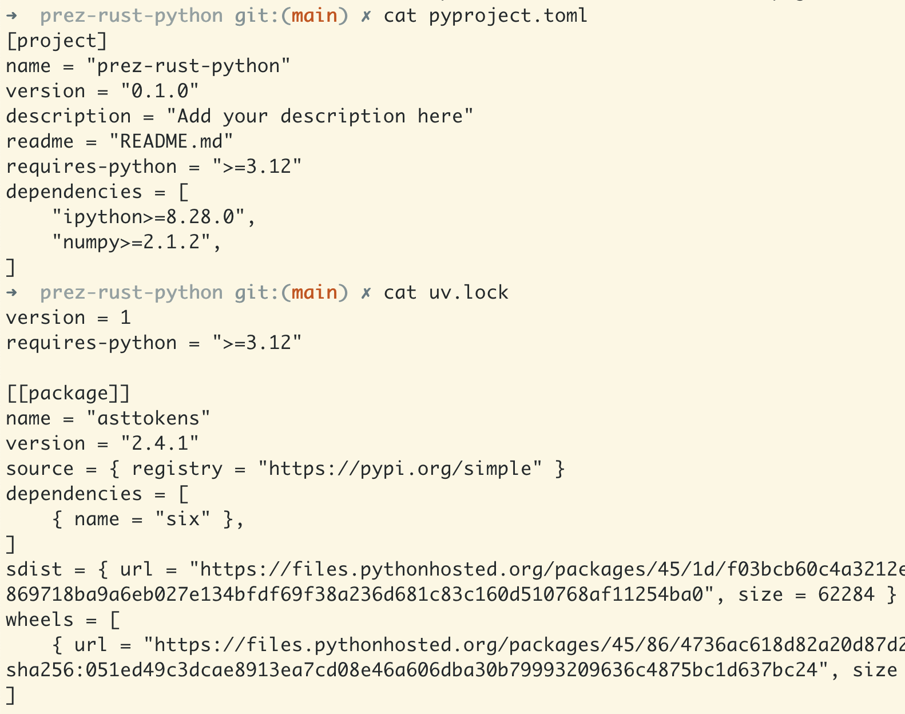

Slide 20
uv Showcase (Installation and Upgrades)
Static binaries for fun and profit

Slide 21
Other Static Binary Package Managers
Micromamba (C++) - based on conda-forge
Like conda / mamba, but without base environment
a pure C++-based CLI, self-contained in a single-file executable

Slide 22
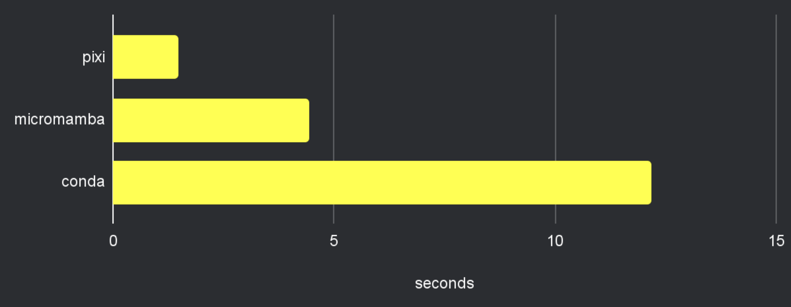
Other Static Binary Package Managers
Pixi (Rust) - based on conda-forge
Env per project, instead of globally located
Up to 4x faster than micromamba
pixi - powerful development environments on Windows, macOS and Linux
7 Reasons to Switch from Conda to Pixi
Adopting uv in pixi

Slide 23
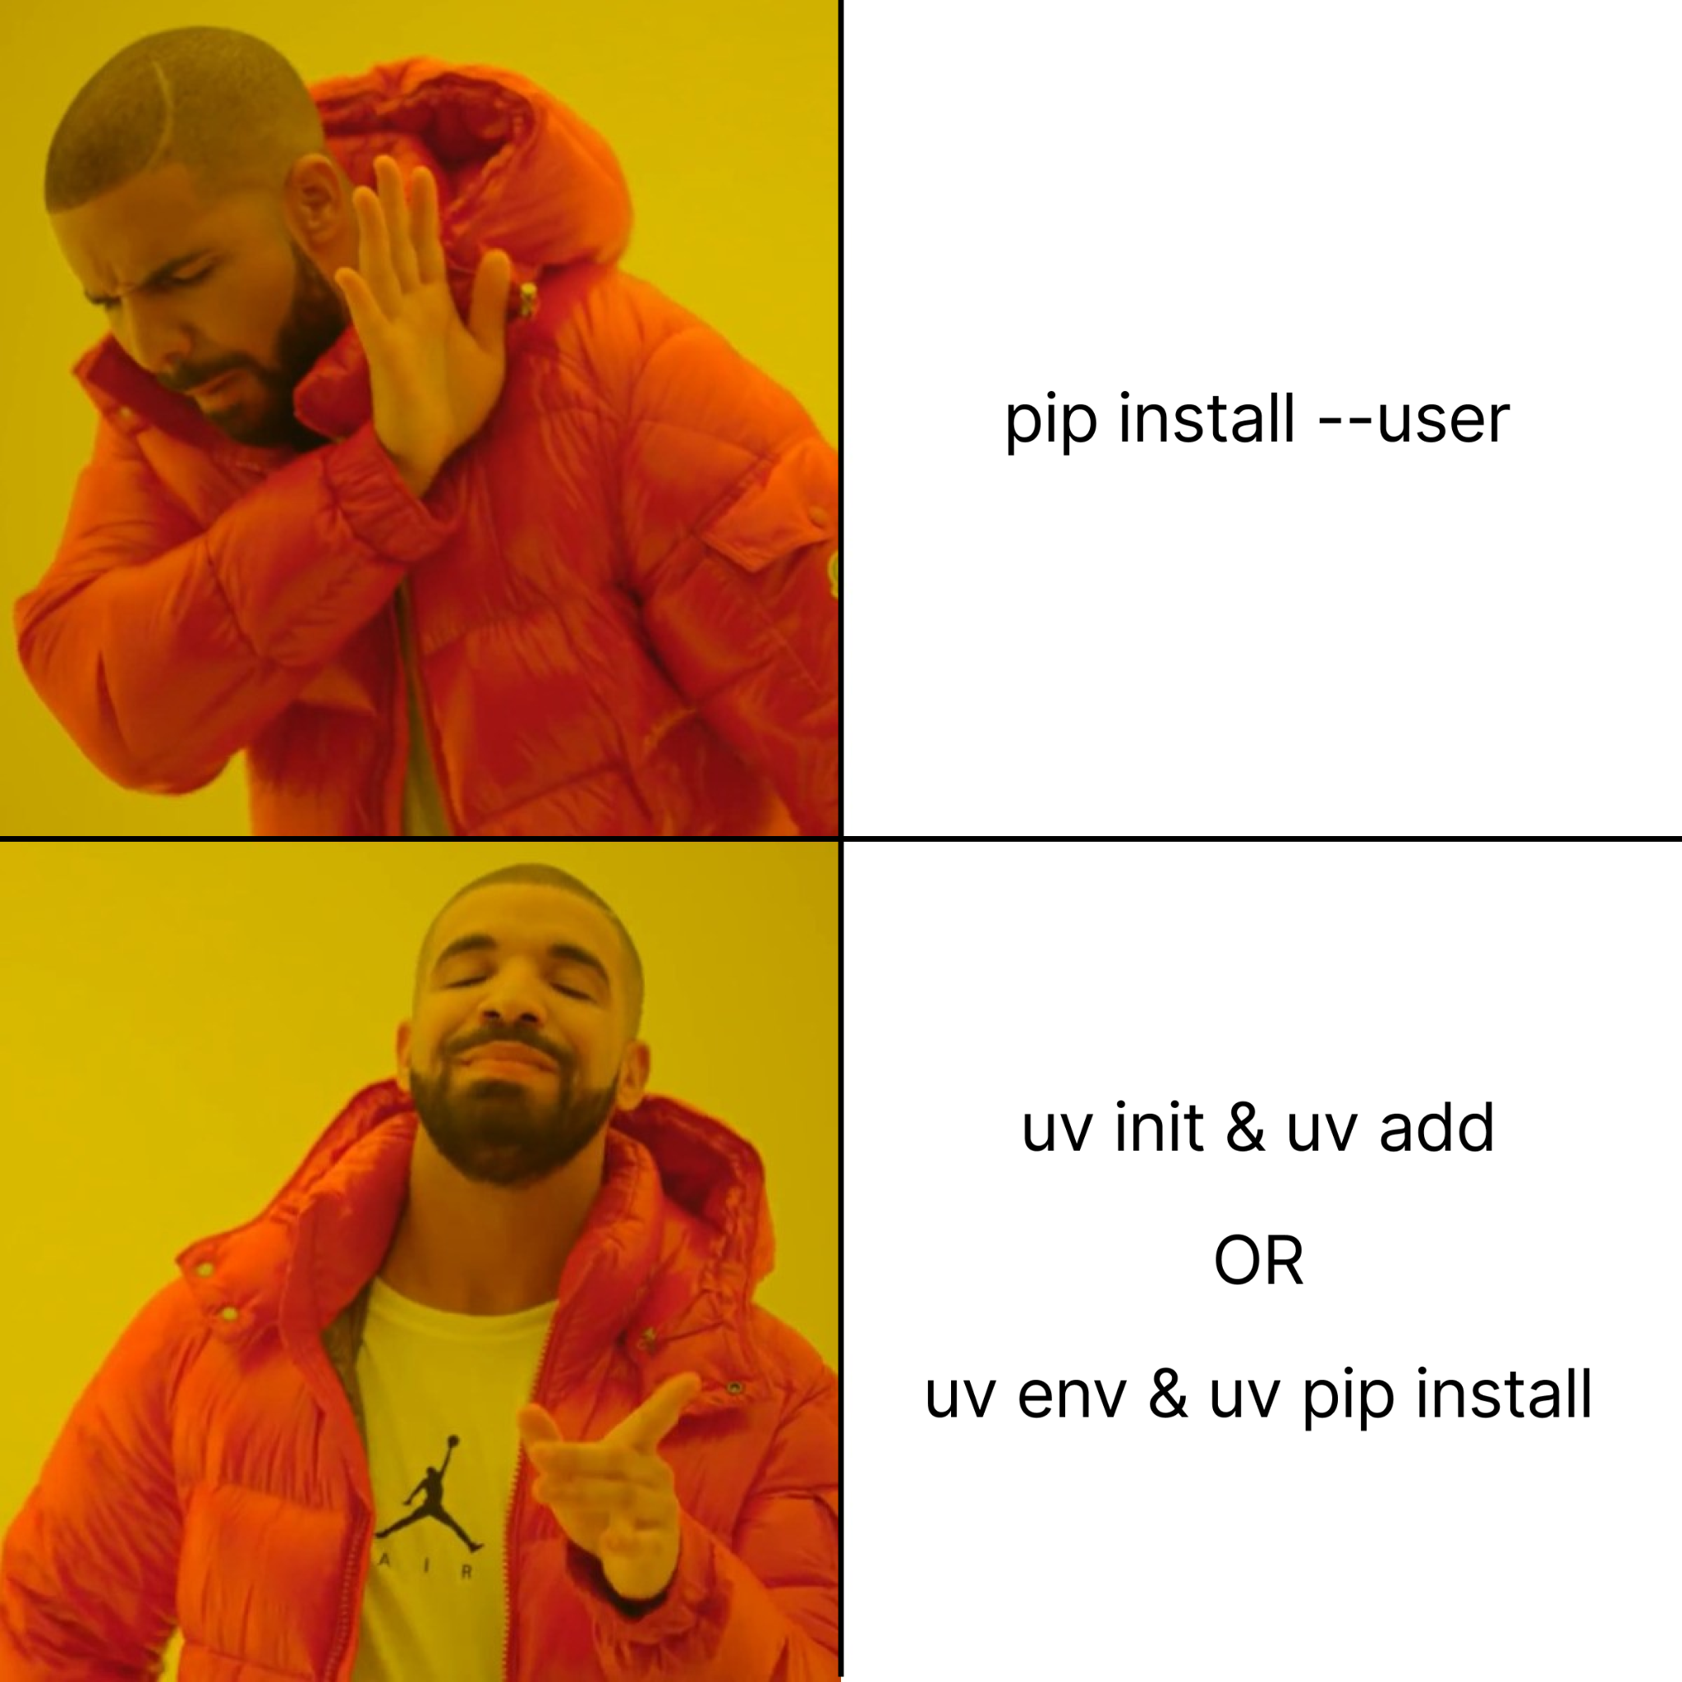
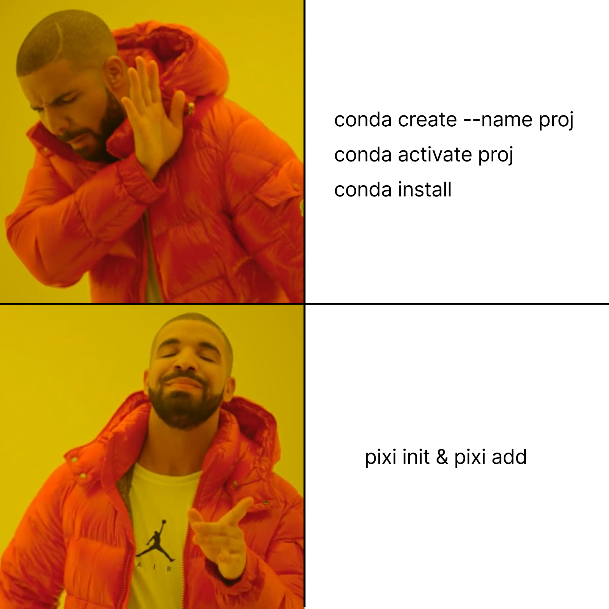
Pattern Spotted!
Per-project envs are good!
Why I Still Use Python Virtual Environments in Docker

Slide 24
Influence: Cargo - the Rust Package Manager
Poetry, uv, and Pixi all took inspiration from Cargo
All have taken inspiration from package managers in the past
Package managers themselves are getting “oxidized”.
Reddit: pip and cargo are not the same
HN: Pip and cargo are not the same
Why I moved away from Poetry for Python

Slide 25
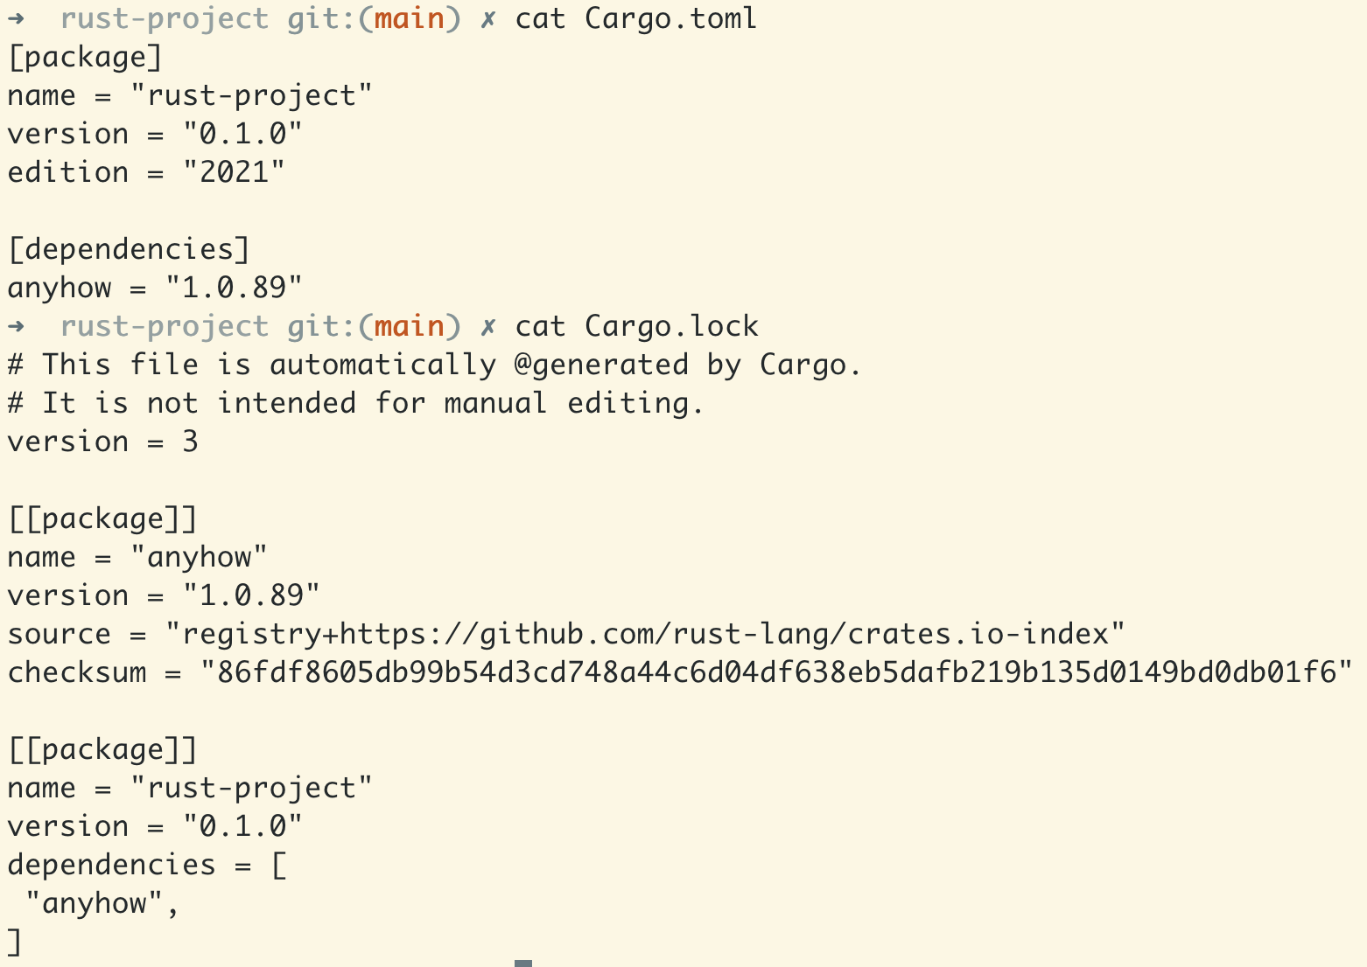

Slide 26
Welcome. Fellow Rustaceans…

Slide 27
Let’s Talk about Python…

Slide 28
Why is Python Slow?
Interpreted, rather than machine code
Dynamic typing: runtime checking overhead, hard to optimize
All objects are heap-allocated (PyObject) with structure even for simple data
Garbage collection: extra work tracking objects, memory fragmentation
Global Interpreter Lock (GIL): in CPython, the GIL limits parallelism
This might change! #nogil
Speed up your data science and scientific computing code
Articles: Speed up your data science and scientific computing code
When Python can’t thread: a deep-dive into the GIL’s impact

Slide 29
But Python is the language for Scientific Computing, Data, and AI
Python is the “glue” layer for compiled (“native”) libraries. Other than Python:
NumPy - C & Cython
SciPy - C, C++, Fortran, Cython & Pythran
Scikit-learn: C++ & Cython
Pandas - C & Cython
lxml - Cython, with libxml2 & libxslt in C
Msgpack-Python - C & Cython
Psycopg2 - C
Cryptography - Previously C / now Rust (PyO3 binding)
SpaCy - Cython
Pillow - C
OpenCV-Python - C++
PyTorch - C++ & CUDA
Dlib - C++ (pybind11 binding)
Faiss - C++ & CUDA (SWIG binding)
Hnswlib - C++ (pybind11 binding)

Slide 30
Awesome Rust Projects with Python Bindings
orjson - Fast, correct Python JSON library supporting dataclasses, datetimes, and numpy
ormsgpack - About Msgpack serialization/deserialization library for Python, written in Rust using PyO3 and rust-msgpack
Polars - Dataframes powered by a multithreaded, vectorized query engine, written in Rust
Tokenizers - Fast State-of-the-Art Tokenizers optimized for Research and Production
pydantic-core - Core validation logic for pydantic written in rust
py-spy - Sampling profiler for Python programs
DataFusion - Apache DataFusion Apache DataFusion SQL Query Engine With Python Bindings
Delta Lake - A native Rust library for Delta Lake, with bindings into Python

Slide 31
What to Use for Faster Code?
A few sane choices
Numba - Just-in-Time (JIT) compilation for simple / numerical routines
Cython for C code
pybind11 for C++ code
PyO3 for Rust code
Let’s build and optimize a Rust extension for Python
The easiest way to speed up Python with Rust
PyO3: From Python to Rust and Back Again (with David Hewitt)
Converting a Python library to Rust
A Python and Rust love story
Let’s have more Rust in Python’s Arrow revolution
Wrapping a Rust Crate in a Python Package
Faster Python calculations with Numba: 2 lines of code, 13× speed-up
Cython, Rust, and more: choosing a language for Python extensions
Some reasons to avoid Cython

Slide 32
Rust as the “Glue” for C/C++
Just like Python is the “glue” for compiled libraries, Rust can be the “glue” for C/C++ libraries.
They all can speak the C Foreign Language Interface (CFFI)
Drastically broadens the world of software options
Encourages memory safety of C/C++ projects through osmosis at interface level
e.g.:
libc - Raw FFI bindings to platforms' system libraries
magic - High level bindings for the `libmagic` C library
libsql - libSQL library: the main gateway for interacting with the database
rocksdb - Rust wrapper for Facebook's RocksDB embeddable database
tch-rs - Rust wrappers for the PyTorch C++ api (libtorch).

Slide 33
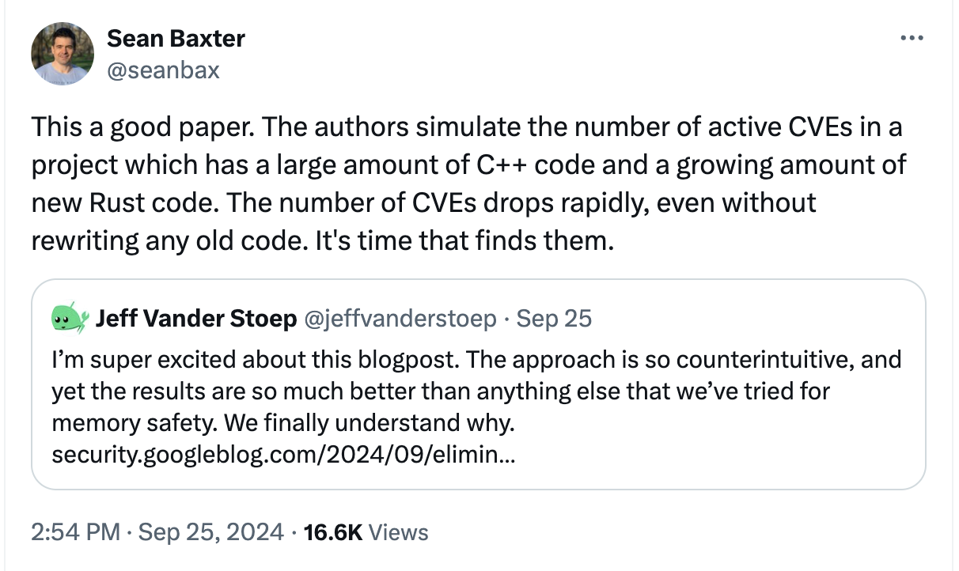
Side Note: Memory Safety Pressuring the C/C++ Community
https://twitter.com/seanbax/status/1839030830968012989

Slide 34
Rust/Python Interop Game Plan
Move performance-critical work one layer lower from Python to Rust, and expose coarse-grained operations to Python
Many small operations - call into Rust once and do all of them there
Further: leave threading to Rust, no Python threads
Further: use async Rust for big-batch network IO and wrap in sync call in Python
Code once in Rust, profit also in other languages through bindings
A Week of PyO3 + rust-numpy (How to Speed Up Your Data Pipeline X Times)

Slide 35
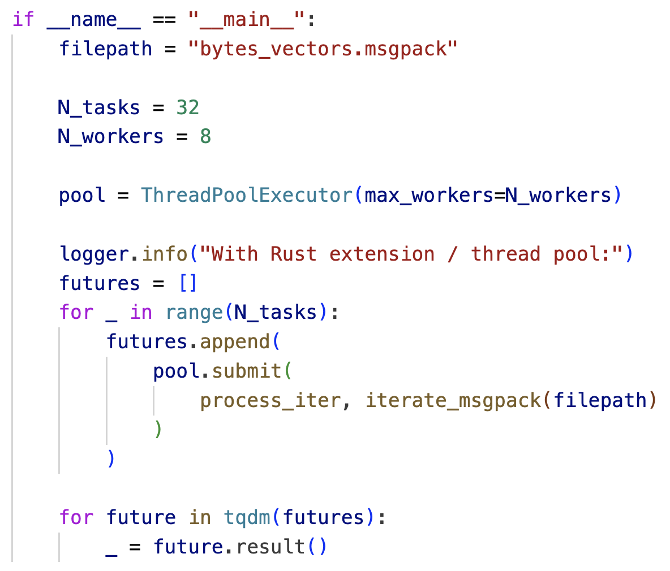
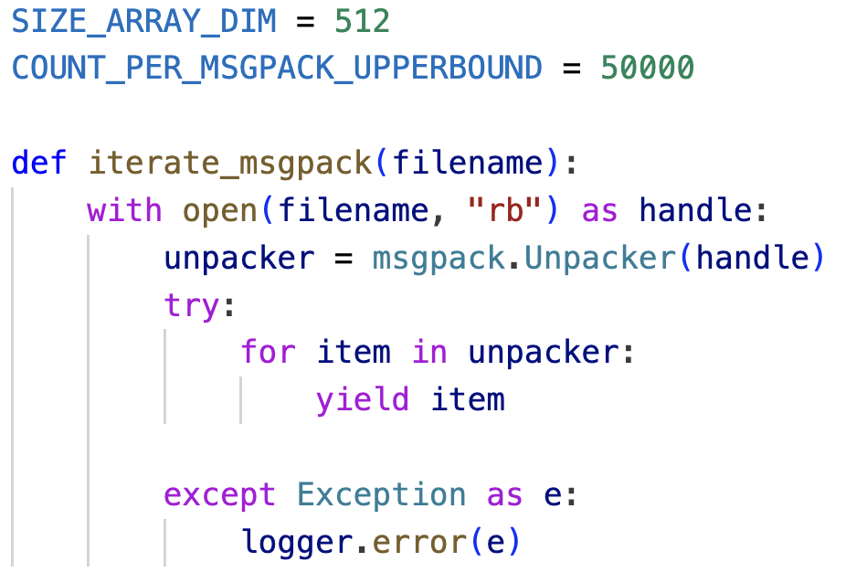
Accelerating Msgpack Data Pipeline - Setup

Slide 36
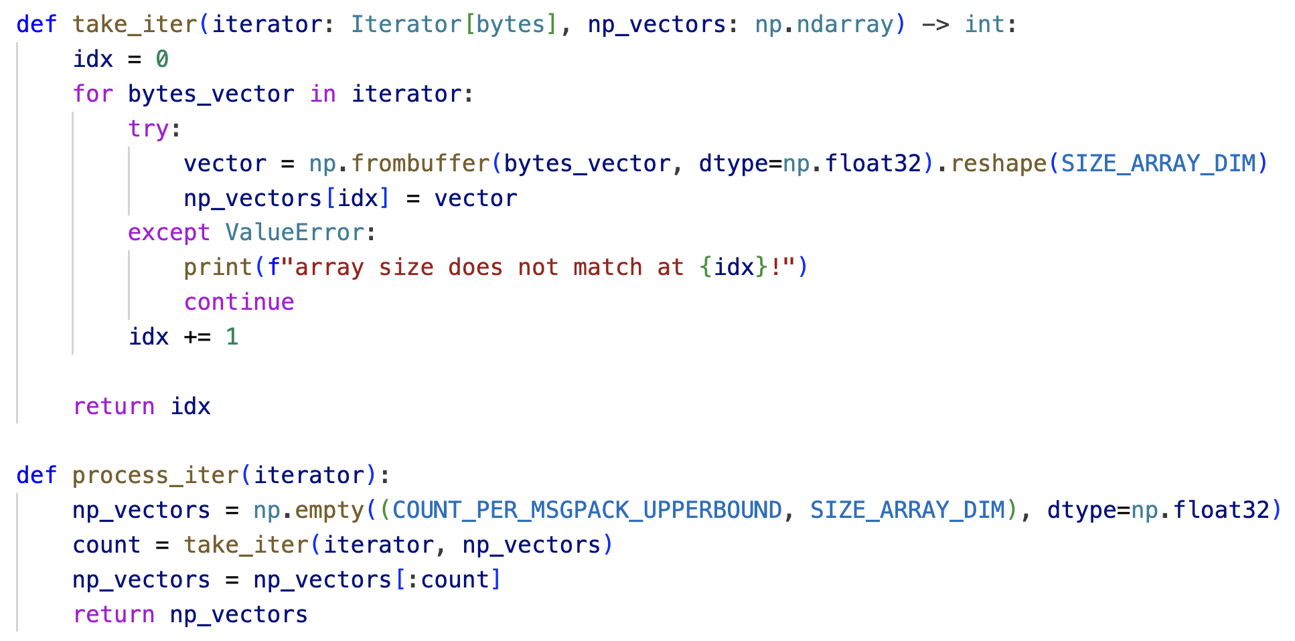
Accelerating Msgpack Data Pipeline - Python Impl

Slide 37
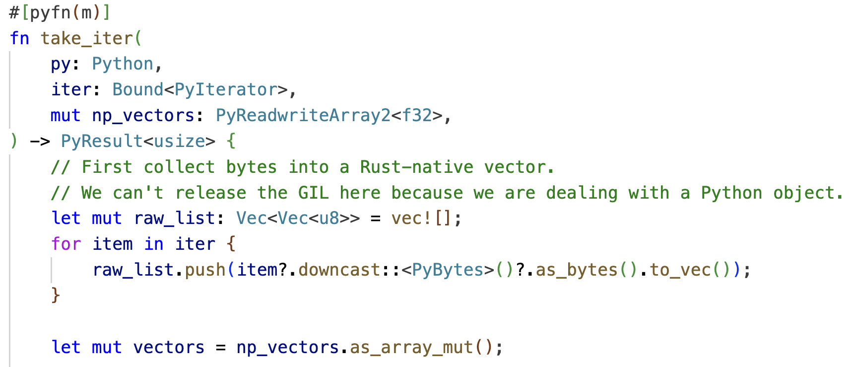
Accelerating Msgpack Data Pipeline - Rust Impl
. . .

Slide 38
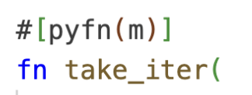
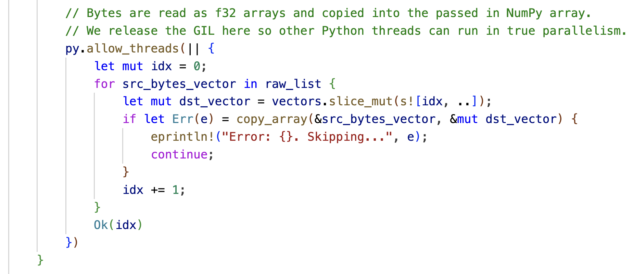
. . .

Slide 39
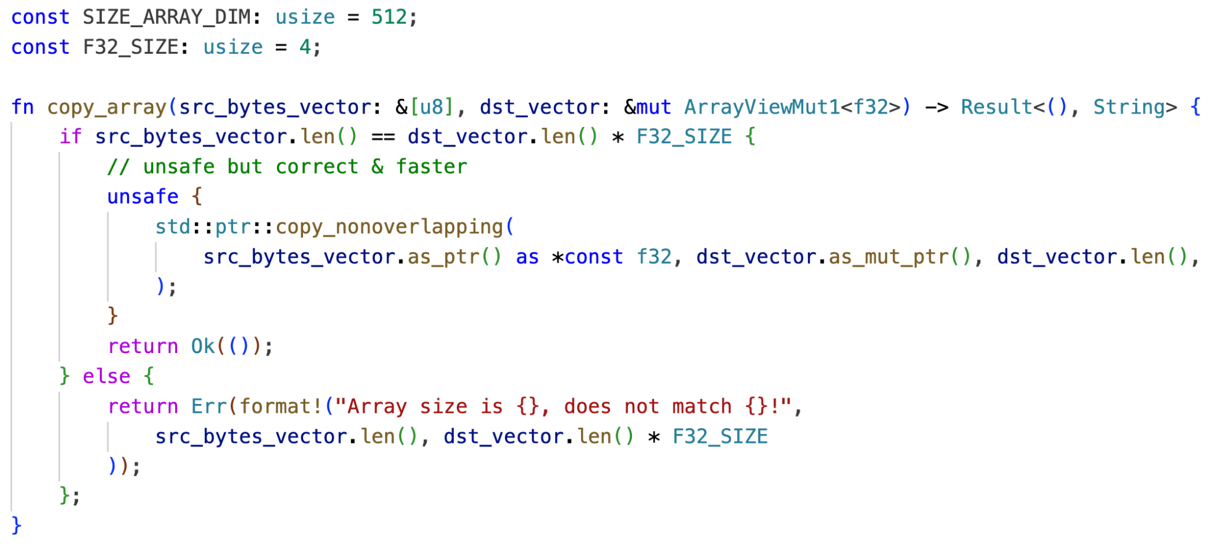
Accelerating Msgpack Data Pipeline - Rust Impl

Slide 40
Speed-Up
1 thread
4 threads
A Week of PyO3 + rust-numpy (How to Speed Up Your Data Pipeline X Times)

Slide 41
If Reading from File and Deserialize in Rust…
1 thread
4 threads
A Week of PyO3 + rust-numpy (How to Speed Up Your Data Pipeline X Times)
msgpack-numpy-rs - msgpack-numpy, but in Rust.

Slide 42
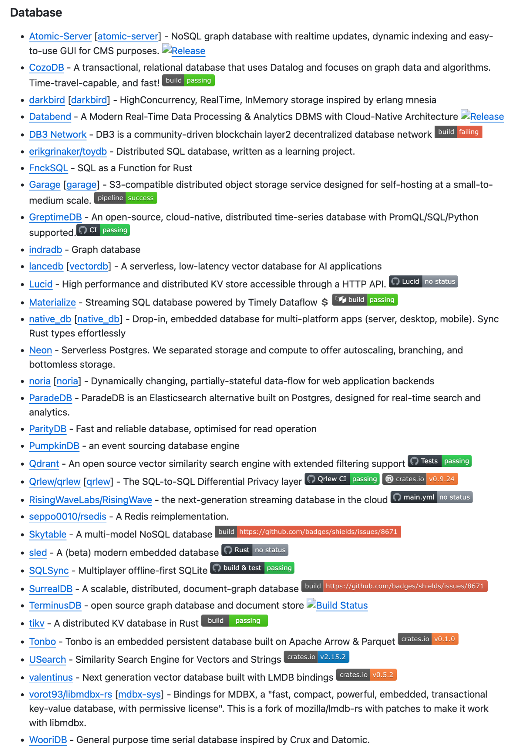
Awesome-Rust - Rich and Thriving Ecosystem

Slide 43
Thank you!

